Slide 1






Setting up Git

Slide 2


Setting up git
A sort of get-to-know-you for git !
Who are you ?
$ git config --global user.name "Vlad Dracula"
How can I contact you ?
$ git config --global user.email "vlad@tran.sylvan.ia" vlad@tran.sylvan.ia
How do we interact ?
$ git config --global core.editor "nano -w"
Let's check:
$ git config –global –edit
A lot of things can be configured:
Default branch name for new projects:
$ git config --global init.defaultBranch main
List all set parameters:
$ git config --list

Slide 3
Exploring history

Slide 4
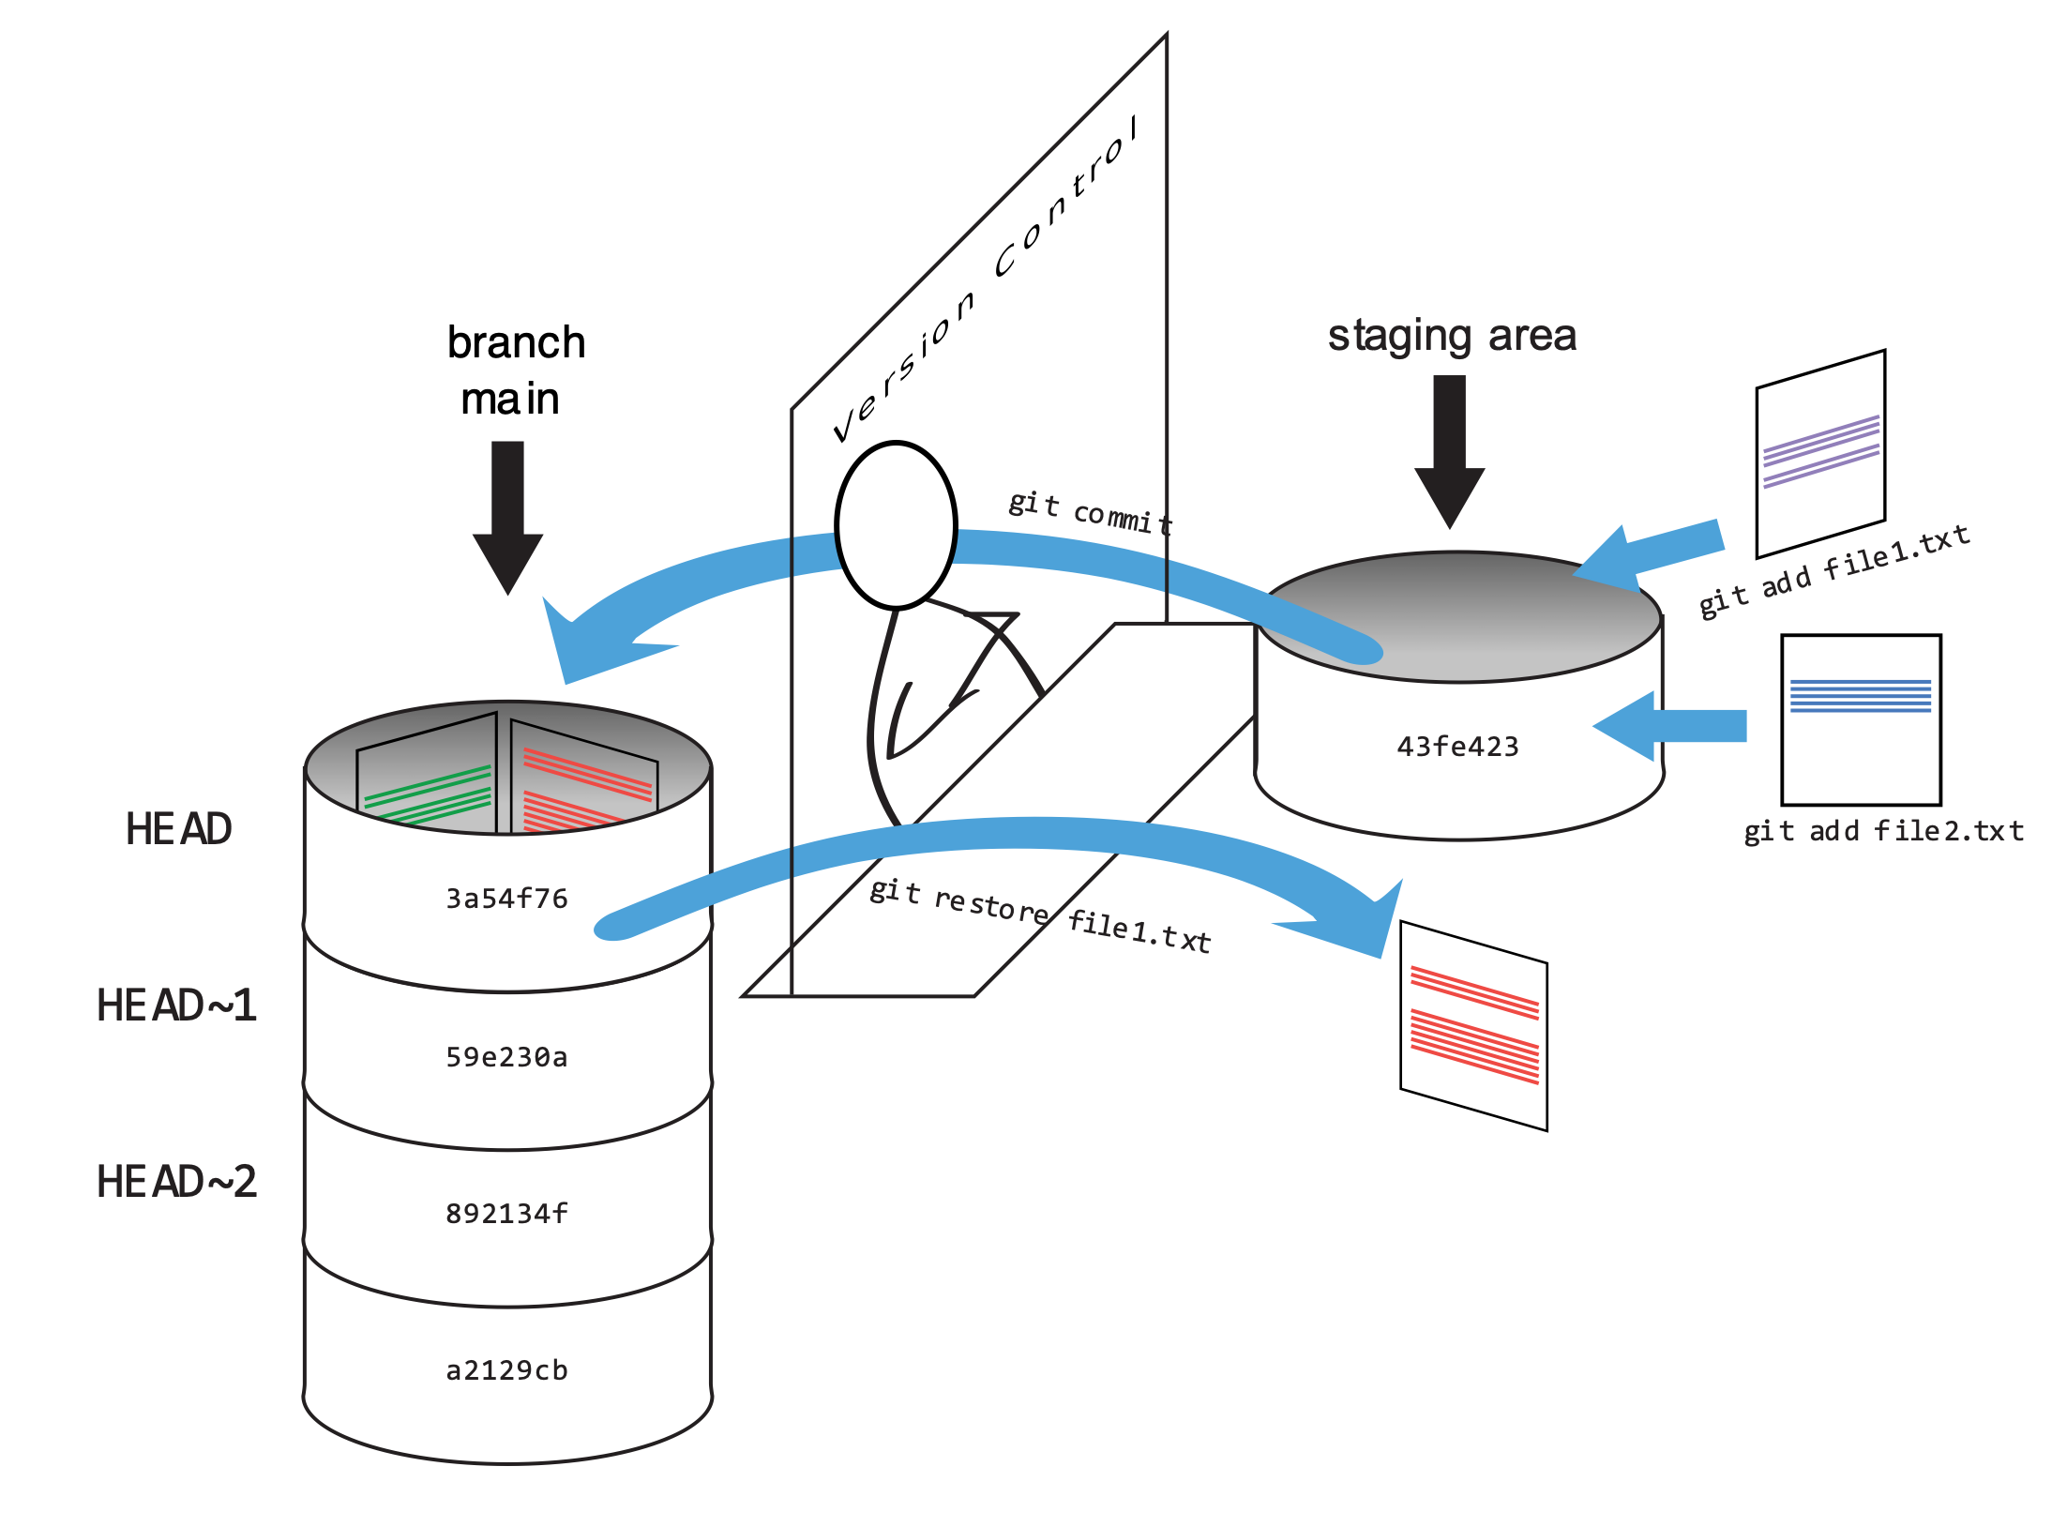

Slide 5
Git branches 101

Slide 6
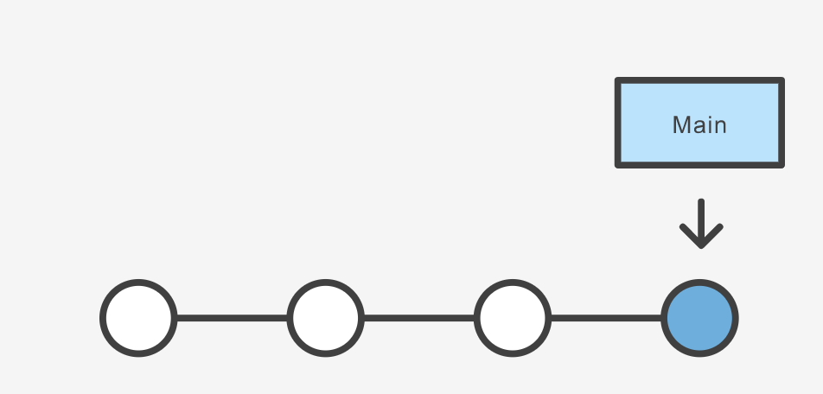
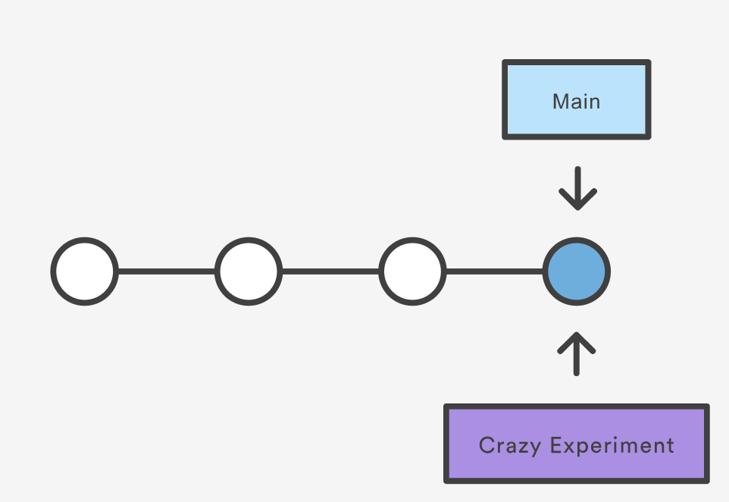
What is a branch ?
Creating a branch only create a new pointer, nothing is changing in your code !
A branch is simply a pointer to a commit !
Illustrations: https://carpentries-incubator.github.io/advanced-git/index.html

Slide 7
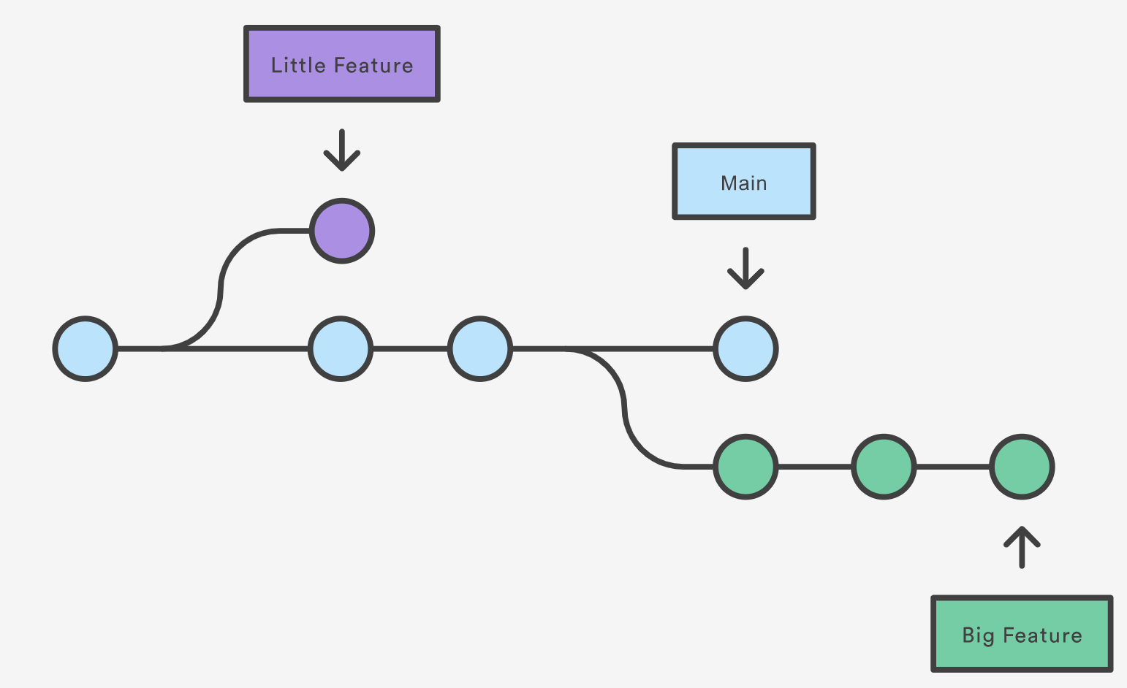
What is a branch ?
Git keep track of the history of a branch by checking the relationship between commits
Illustrations: https://carpentries-incubator.github.io/advanced-git/index.html

Slide 8
Git best practices

Slide 9
Scenario
Jeanette is working on her own project that uses Magnet7.
Over the course of a year she changed quite a few useful things on her own branch and she wants to contribute those changes to the develop branch (and eventually to the main branch).
She opens a merge request, but finds out that she has merge conflicts in all the files that she changed. It takes her several days and a lot of headaches to resolve the conflicts.
Carsten reviews the merge request and finds that many useful additions were accidentally changed by Jeannette in the merge conflict resolution. It takes him several days and a lot of headaches to find a way to incorporate Jeannette’s changes whilst maintaining functioning code.
How can you avoid this?

Slide 10
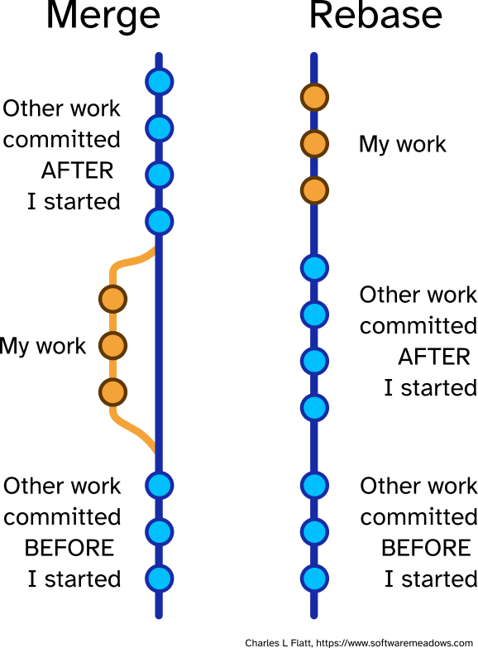
Merging vs rebasing

Slide 11
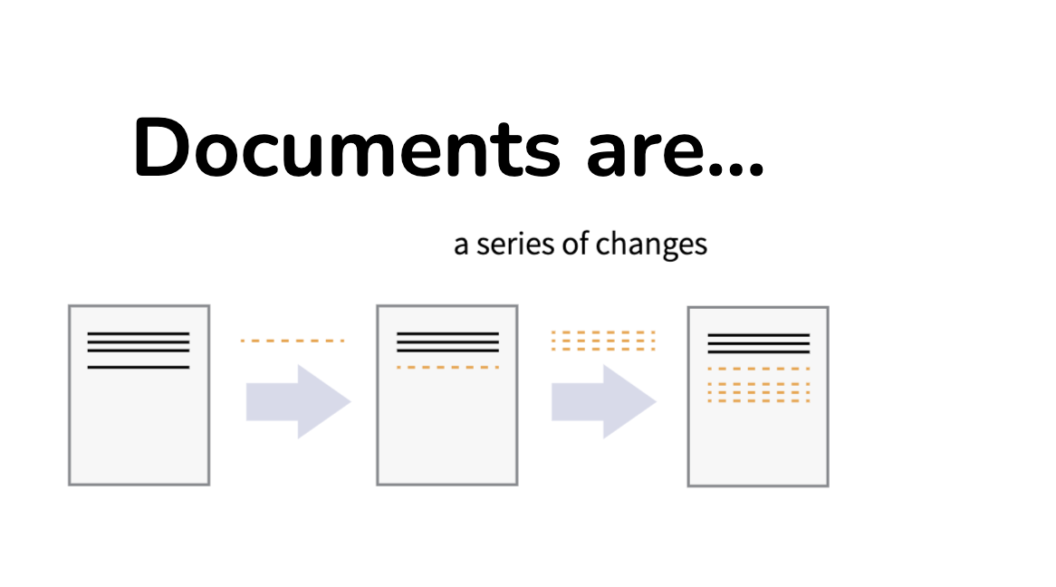
How about storing large files? Remember that:

Slide 12
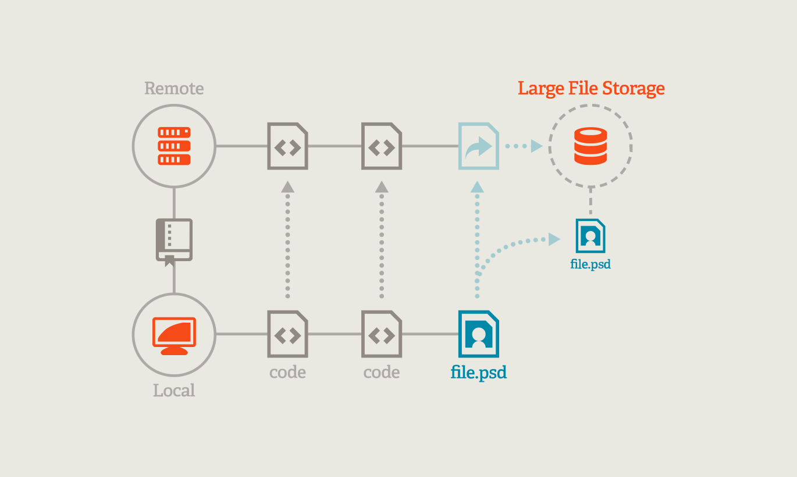
How to store large files with git?
Show .gitattributes file
Show .har files in 7_databases / Data_Gtap11C_Waste

Slide 13
Blobless cloning: clone a repository without large binary objects (blobs)
git clone --filter=blob:none <url>

Slide 14
Wrap up

Slide 15
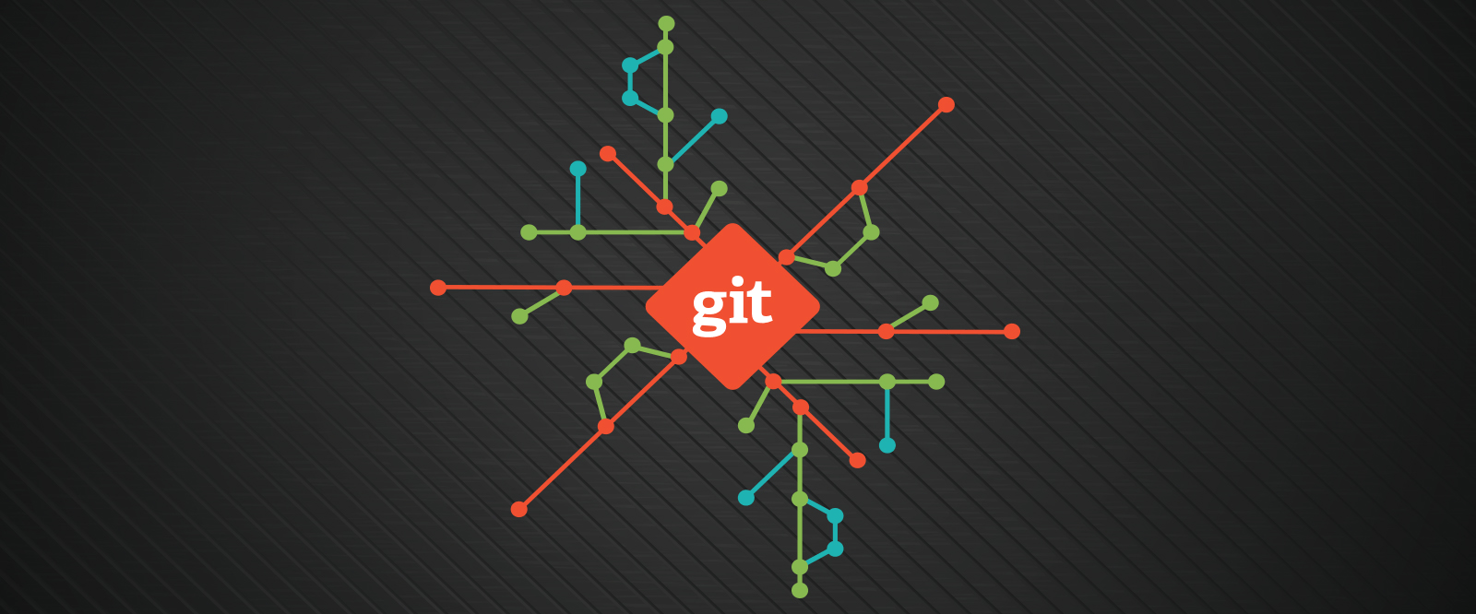
Congratulations!
You are now competent Git and GitLab users

Slide 16
Appreciate what you learned today
Configuring Git
Tracking changes: git status, git add & git commit
Exploring history: identify and recover old versions of files
Ignoring things with .gitignore files
Remote repositories in GitLab
Git branches
Submitting changes through merge requests in GitLab
The peer review process
Dealing with merge conflicts
Using issues and the git workflow
Good practices for collaboration @MAGNET: dealing with large files, keep your branch in sync, git stash, merging vs rebasing

Slide 17
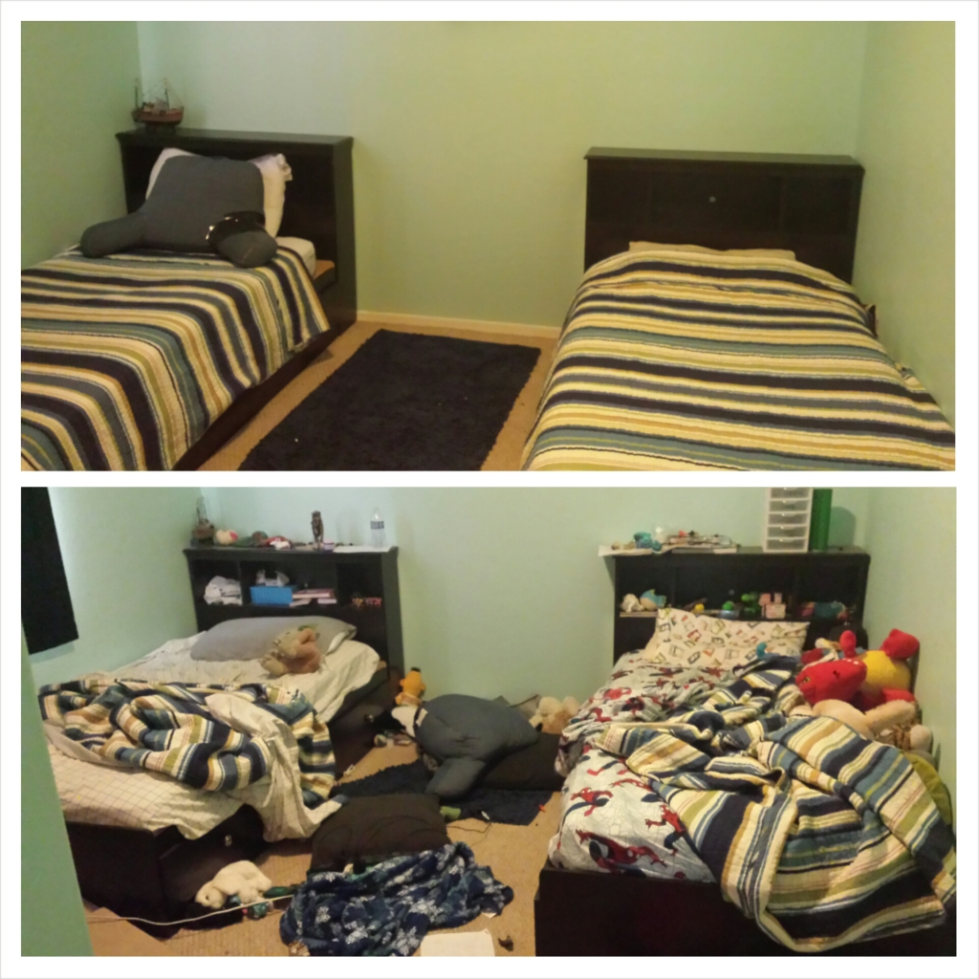
Take-home message
Everyone will benefit from keeping the GitLab project tidy.
It is a shared responsbility.

Slide 18








Let’s stay in touch
https://www.esciencecenter.nl/digital-skills/
training@esciencecenter.nl
+31 (0)20 460 4770
@eScienceCenter
Netherlands Escience Center
@eScienceCenter@akademienl.social

